Slide 1
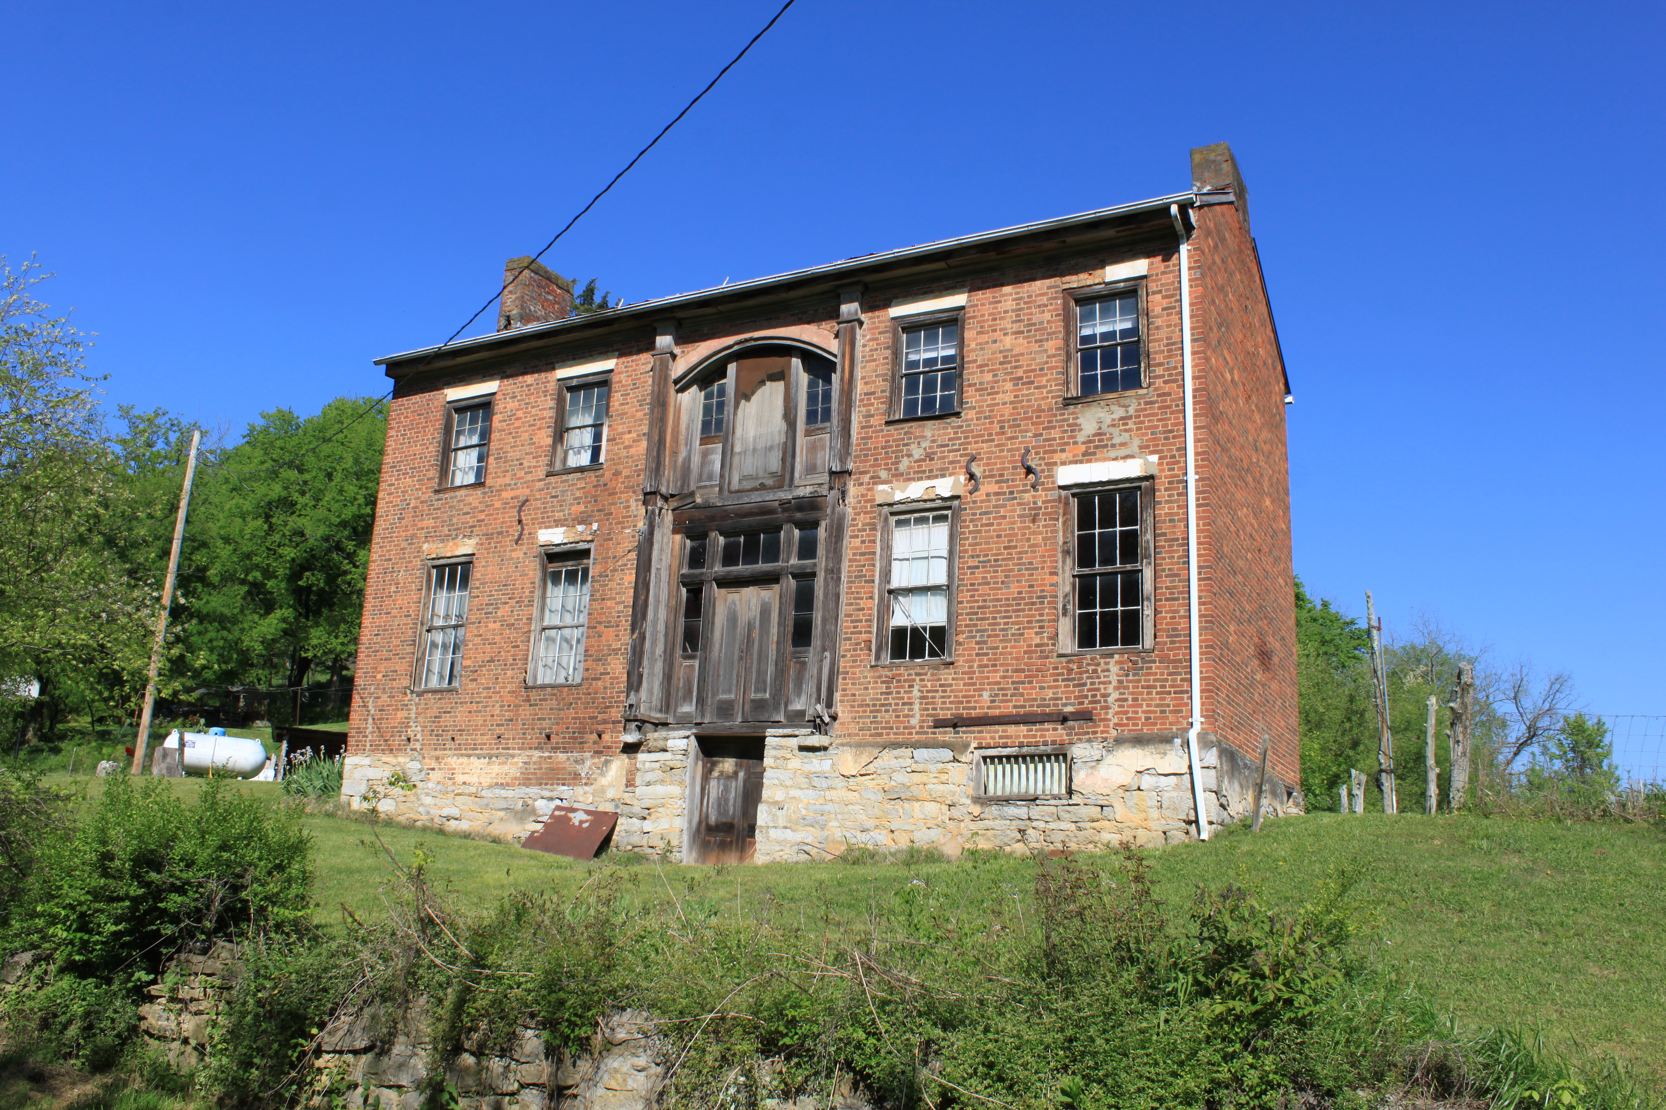
Disclose It!
A Song About the Duty to Disclose Defects in Real Property
Sponsored by Mr. Lucas Salava
For the
2011 Chapman Law School Public Interest Law Foundation Fundraiser
Words and Music Uncopyright Tom W. Bell. Version 2015.11.23
Notes:
Photo by Dwight Burdette
Under Creative Commons Attribution 3.0 Unported License
https://commons.wikimedia.org/wiki/File:Old_Abandoned_House_Newport_Tennessee.JPG

Slide 2
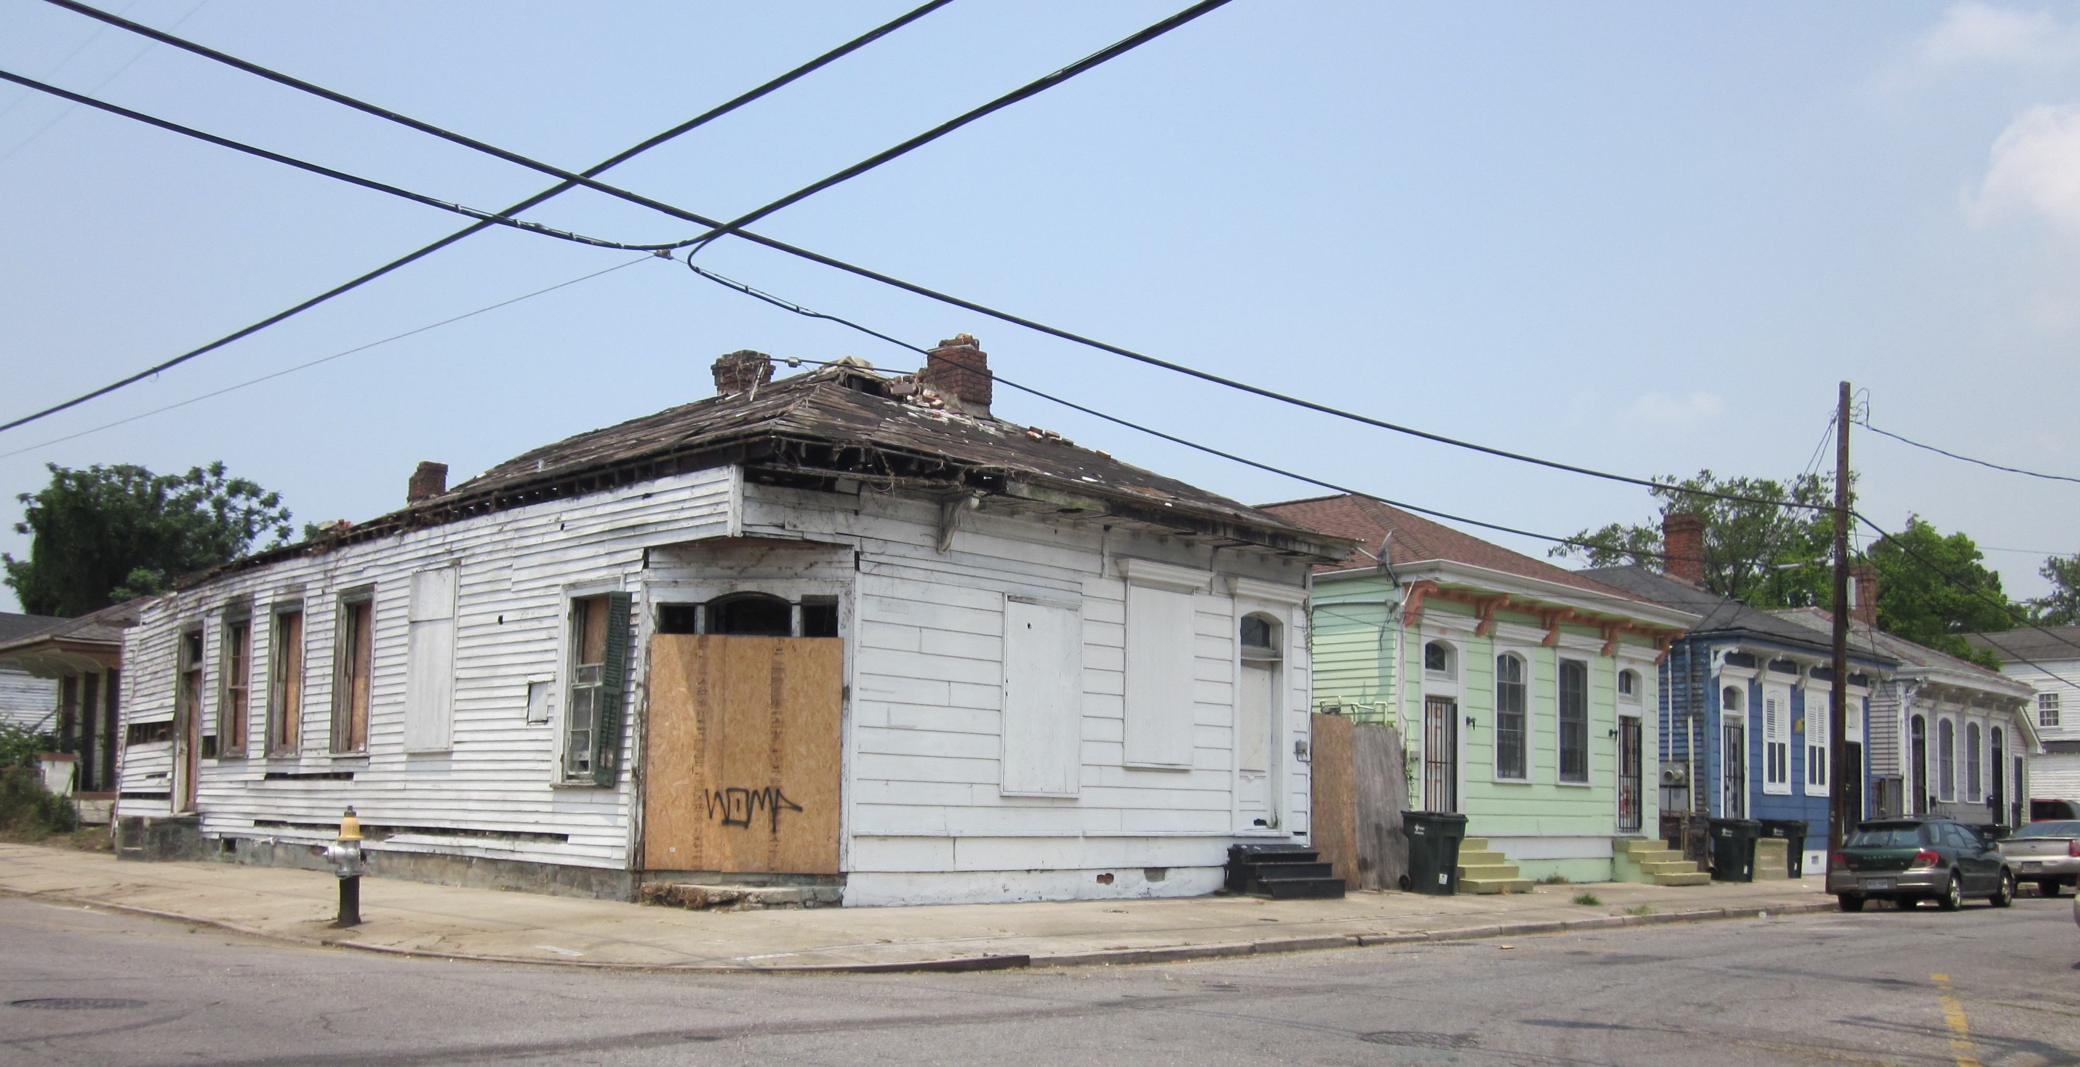
Intro
Verse 1
Verse 2
Refrain
Verse 3
Verse 4
Refrain
Bridge
Verse 1 (reprise)
Coda
Intro:
D F Am E7
[Note: This song describes the basic legal principles that govern the warranties applicable to the sale of real property—residences, in particular—including the duty to disclose, its scope, and the consequences of its breach.]
Disclose It!, v. 2015.11.23
Notes:
Photo by Infrogmation
Licensed under the Creative Commons Attribution-Share Alike 2.0 Generic license.
https://commons.wikimedia.org/wiki/File:Baronne_at_Second_Down_River_June_2011.jpg

Slide 3
Intro
Verse 1
Verse 2
Refrain
Verse 3
Verse 4
Refrain
Bridge
Verse 1 (reprise)
Coda
Verse 1:
D F C G
You’ve got curb ap-peal, but I’ve got to have more.
D F C C7 C
Than beauty that lies on the skin.
D F C G Gadd4 G
What will I find when you open that door?
D F D F
Gotta’dis- close it baby, gotta’ dis- close.
[Note: Even jurisdictions that have not yet abandoned the doctrine of caveat emptor protect purchasers from active concealment, misrepresentation, or failure to disclose material defects not subject to discovery by reasonably prudent buyers.]
Disclose It!, v. 2015.11.23

Slide 4
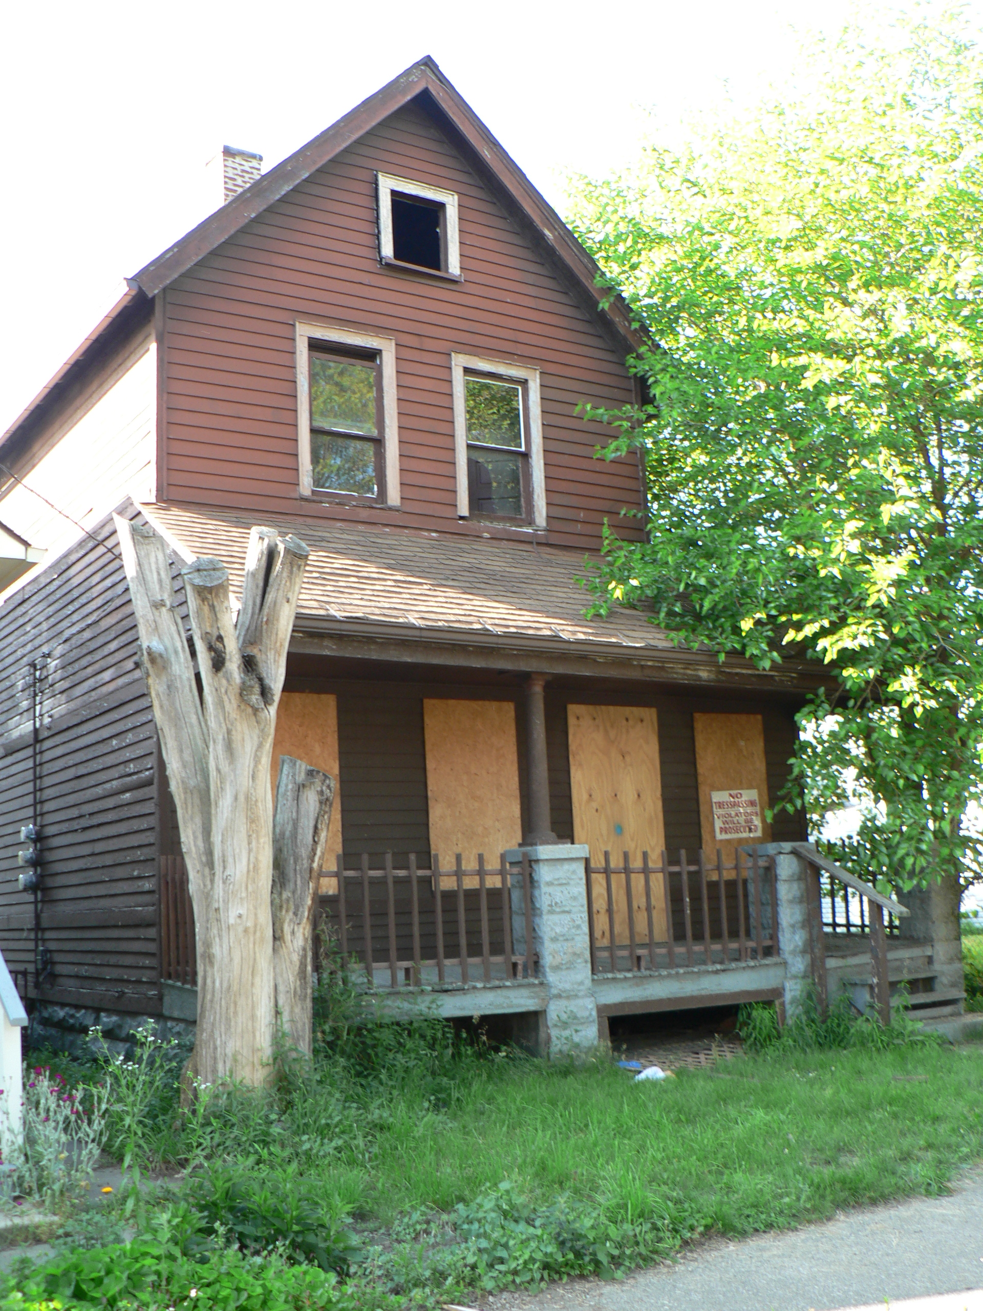
Intro
Verse 1
Verse 2
Refrain
Verse 3
Verse 4
Refrain
Bridge
Verse 1 (reprise)
Coda
Verse 2:
You’re making me promises, inside and out.
You say that I ought to move in.
You make it sound sweet, but it’s makin’ me doubt.
Gotta’ disclose it, baby, gotta’ disclose.
D F Am C
The truth, yeah, dis- robe it, baby. Come on, dis- close,
Am C E E E7 E E
What I should know to me.
[Note: Partial disclosure may give rise to a duty of full disclosure.]
Disclose It!, v. 2012.01.27
Notes:
Photo by Stuart Spivack
Licensed under the Creative Commons Attribution-Share Alike 2.0 Generic license.
https://commons.wikimedia.org/wiki/File:Abandoned_Home_in_Cleveland.jpg

Slide 5
Intro
Verse 1
Verse 2
Refrain
Verse 3
Verse 4
Refrain
Bridge
Verse 1 (reprise)
Coda
Refrain:
E!/Em E!/Em
Whatcha’ trying to hide? Look me straight in the eye.
E!/Em G C
Don’t play it shy. Dis- close it to me!
E!/Em E!/Em
All the risk, all the woe, you do or should know,
E!/E G C
Be- hind or below—dis- close it to me!
G C G C A
Dis- close it to me. Un- clothe it! Dis- close it for me.
A Asus2 A A A A
Disclose It!, v. 2015.11.23

Slide 6
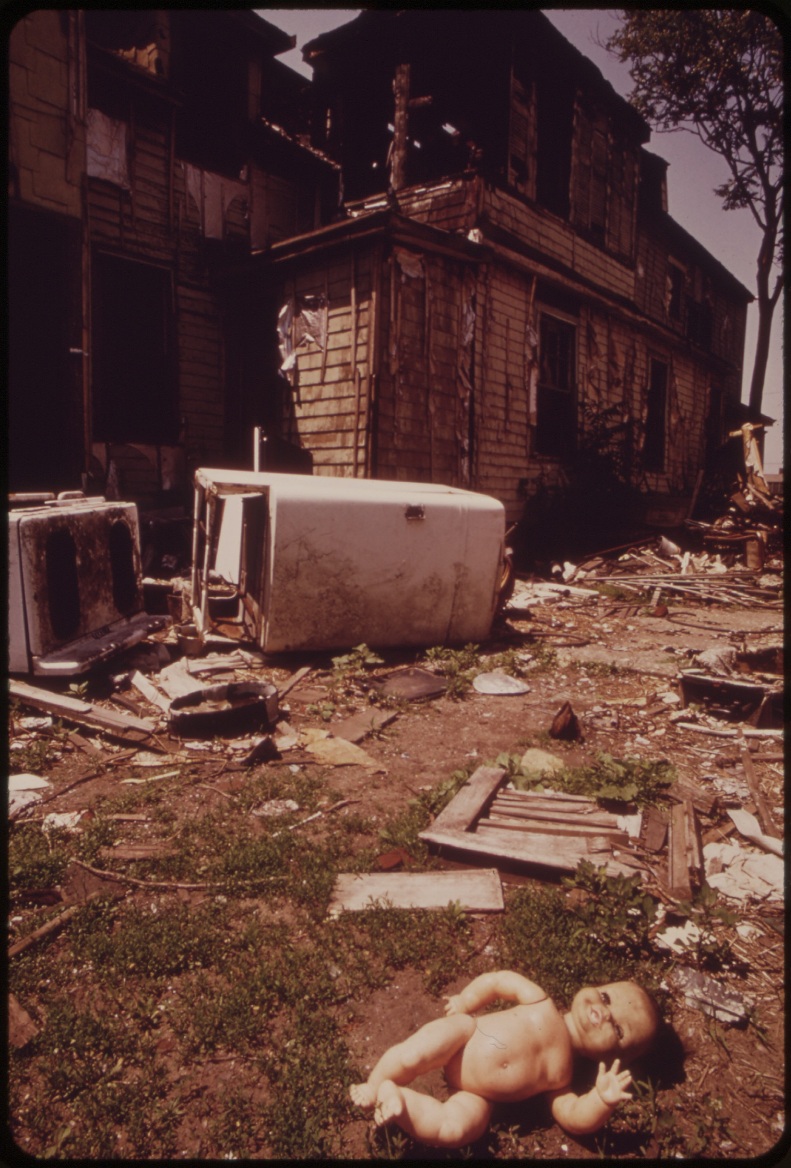
Intro
Verse 1
Verse 2
Refrain
Verse 3
Verse 4
Refrain
Bridge
Verse 1 (reprise)
Coda
Verse 3:
Thanks for the show, yeah; I had a good look,
But ugly can hide behind nice.
Lie and I’ll take back all that you took.
Gotta’ disclose it, baby, gotta’ disclose.
[Note: Inspection, though typical, does not foreclose a buyer from claiming breach of the implied warranty of suitability or quality with regard to defects not discoverable through such means. Breach of such a warranty typically gives rise to a claim for rescission as a matter of equity.]
Disclose It!, v. 2015.11.23
Notes:
Photo provided to Wikimedia Commons by the National Archives and Records Administration as part of a cooperation project. The National Archives and Records Administration provides images depicting American and global history which are public domain or licensed under a free license.
Frank J. (Frank John) Aleksandrowicz, 1921-, Photographer
https://commons.wikimedia.org/wiki/File:ABANDONED_INNER_CITY_HOME_AT_10212_WILBUR_AVENUE_ATTRACTS_VANDALS_AND_LITTERBUGS_-_NARA_-_550263.jpg

Slide 7
Intro
Verse 1
Verse 2
Refrain
Verse 3
Verse 4
Refrain
Bridge
Verse 1 (reprise)
Coda
Verse 4:
Confess and I’ll listen. We might strike a deal.
Some pains I will bear for a price.
Speak well and true to me. Make your appeal.
Gotta’ disclose it, baby, gotta’ disclose.
The truth, yeah, disrobe it, baby. Come on, disclose,
What I should to know to me.
[Note: Implied warranties of suitability or quality may be excluded or modified by agreement (though some jurisdictions refuse to enforce a general disclaimer with respect to residential properties).]
Disclose It!, v. 2015.11.23

Slide 8
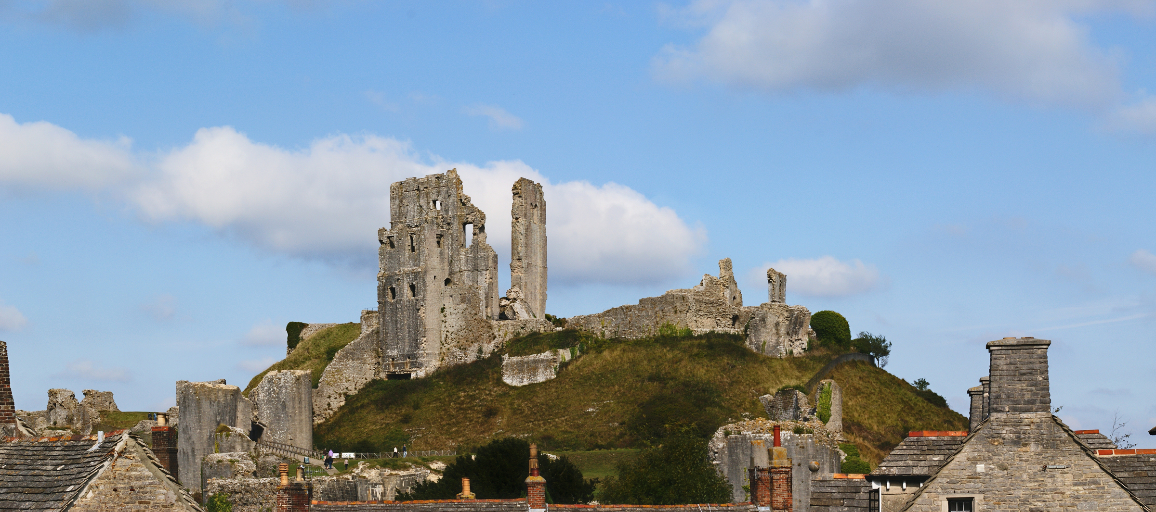
Intro
Verse 1
Verse 2
Refrain
Verse 3
Verse 4
Refrain
Bridge
Verse 1 (reprise)
Coda
Refrain:
Whatcha’ trying to hide? Look me straight in the eye.
Don’t play it shy. Disclose it to me!
All the risk, all the woe, you do or should know,
Behind or below—disclose it to me!
Unclothe it for me. Disclose it! Disclose it to me.
Disclose It!, v. 2015.11.23
Notes:
Photo licensed under the Creative Commons Attribution-Share Alike 4.0 International, 3.0 Unported, 2.5 Generic, 2.0 Generic and 1.0 Generic license.
Author: Herbythyme
https://commons.wikimedia.org/wiki/File:Corfe_Castle_stitch_2.jpg

Slide 9
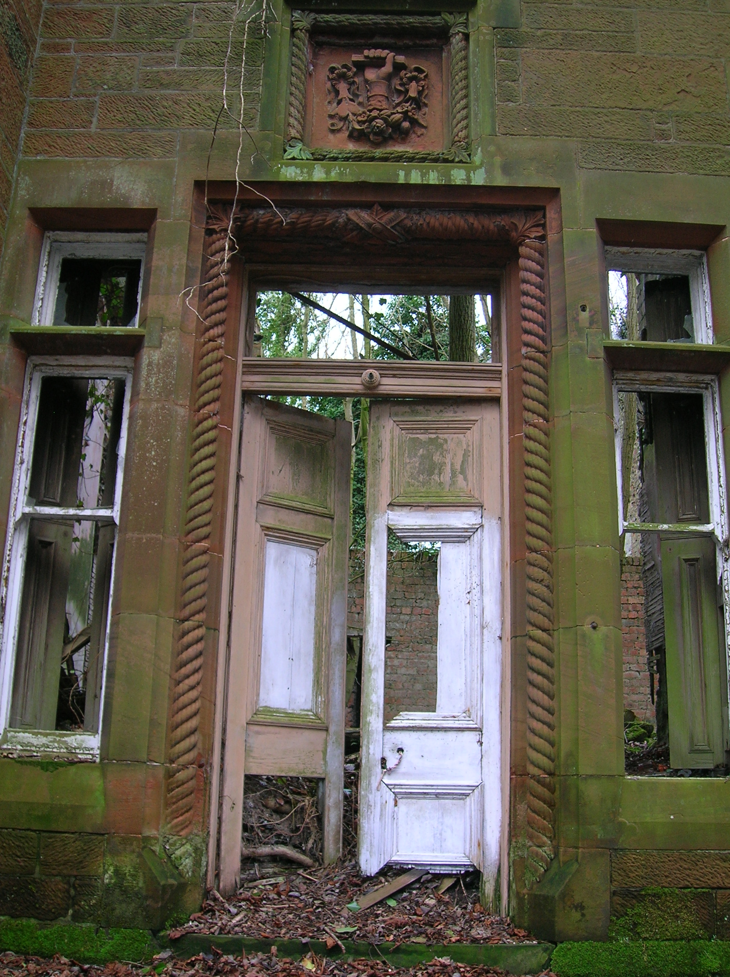
Intro
Verse 1
Verse 2
Refrain
Verse 3
Verse 4
Refrain
Bridge
Verse 1 (reprise)
Coda
Disclose It!, v. 2015.11.23
Notes:
http://upload.wikimedia.org/wikipedia/commons/8/8e/Dalmore_House%2C_front_door%2C_Stair.JPG

Slide 10
Intro
Verse 1
Verse 2
Refrain
Verse 3
Verse 4
Refrain
Bridge
Verse 1 (reprise)
Coda
Coda:
Come on, disclose, what I should know to me.
E!/E G C Am Am7 G
Disclose It!, v. 2015.11.23
Notes:
http://upload.wikimedia.org/wikipedia/commons/7/75/Sold-sign.jpg

Slide 11
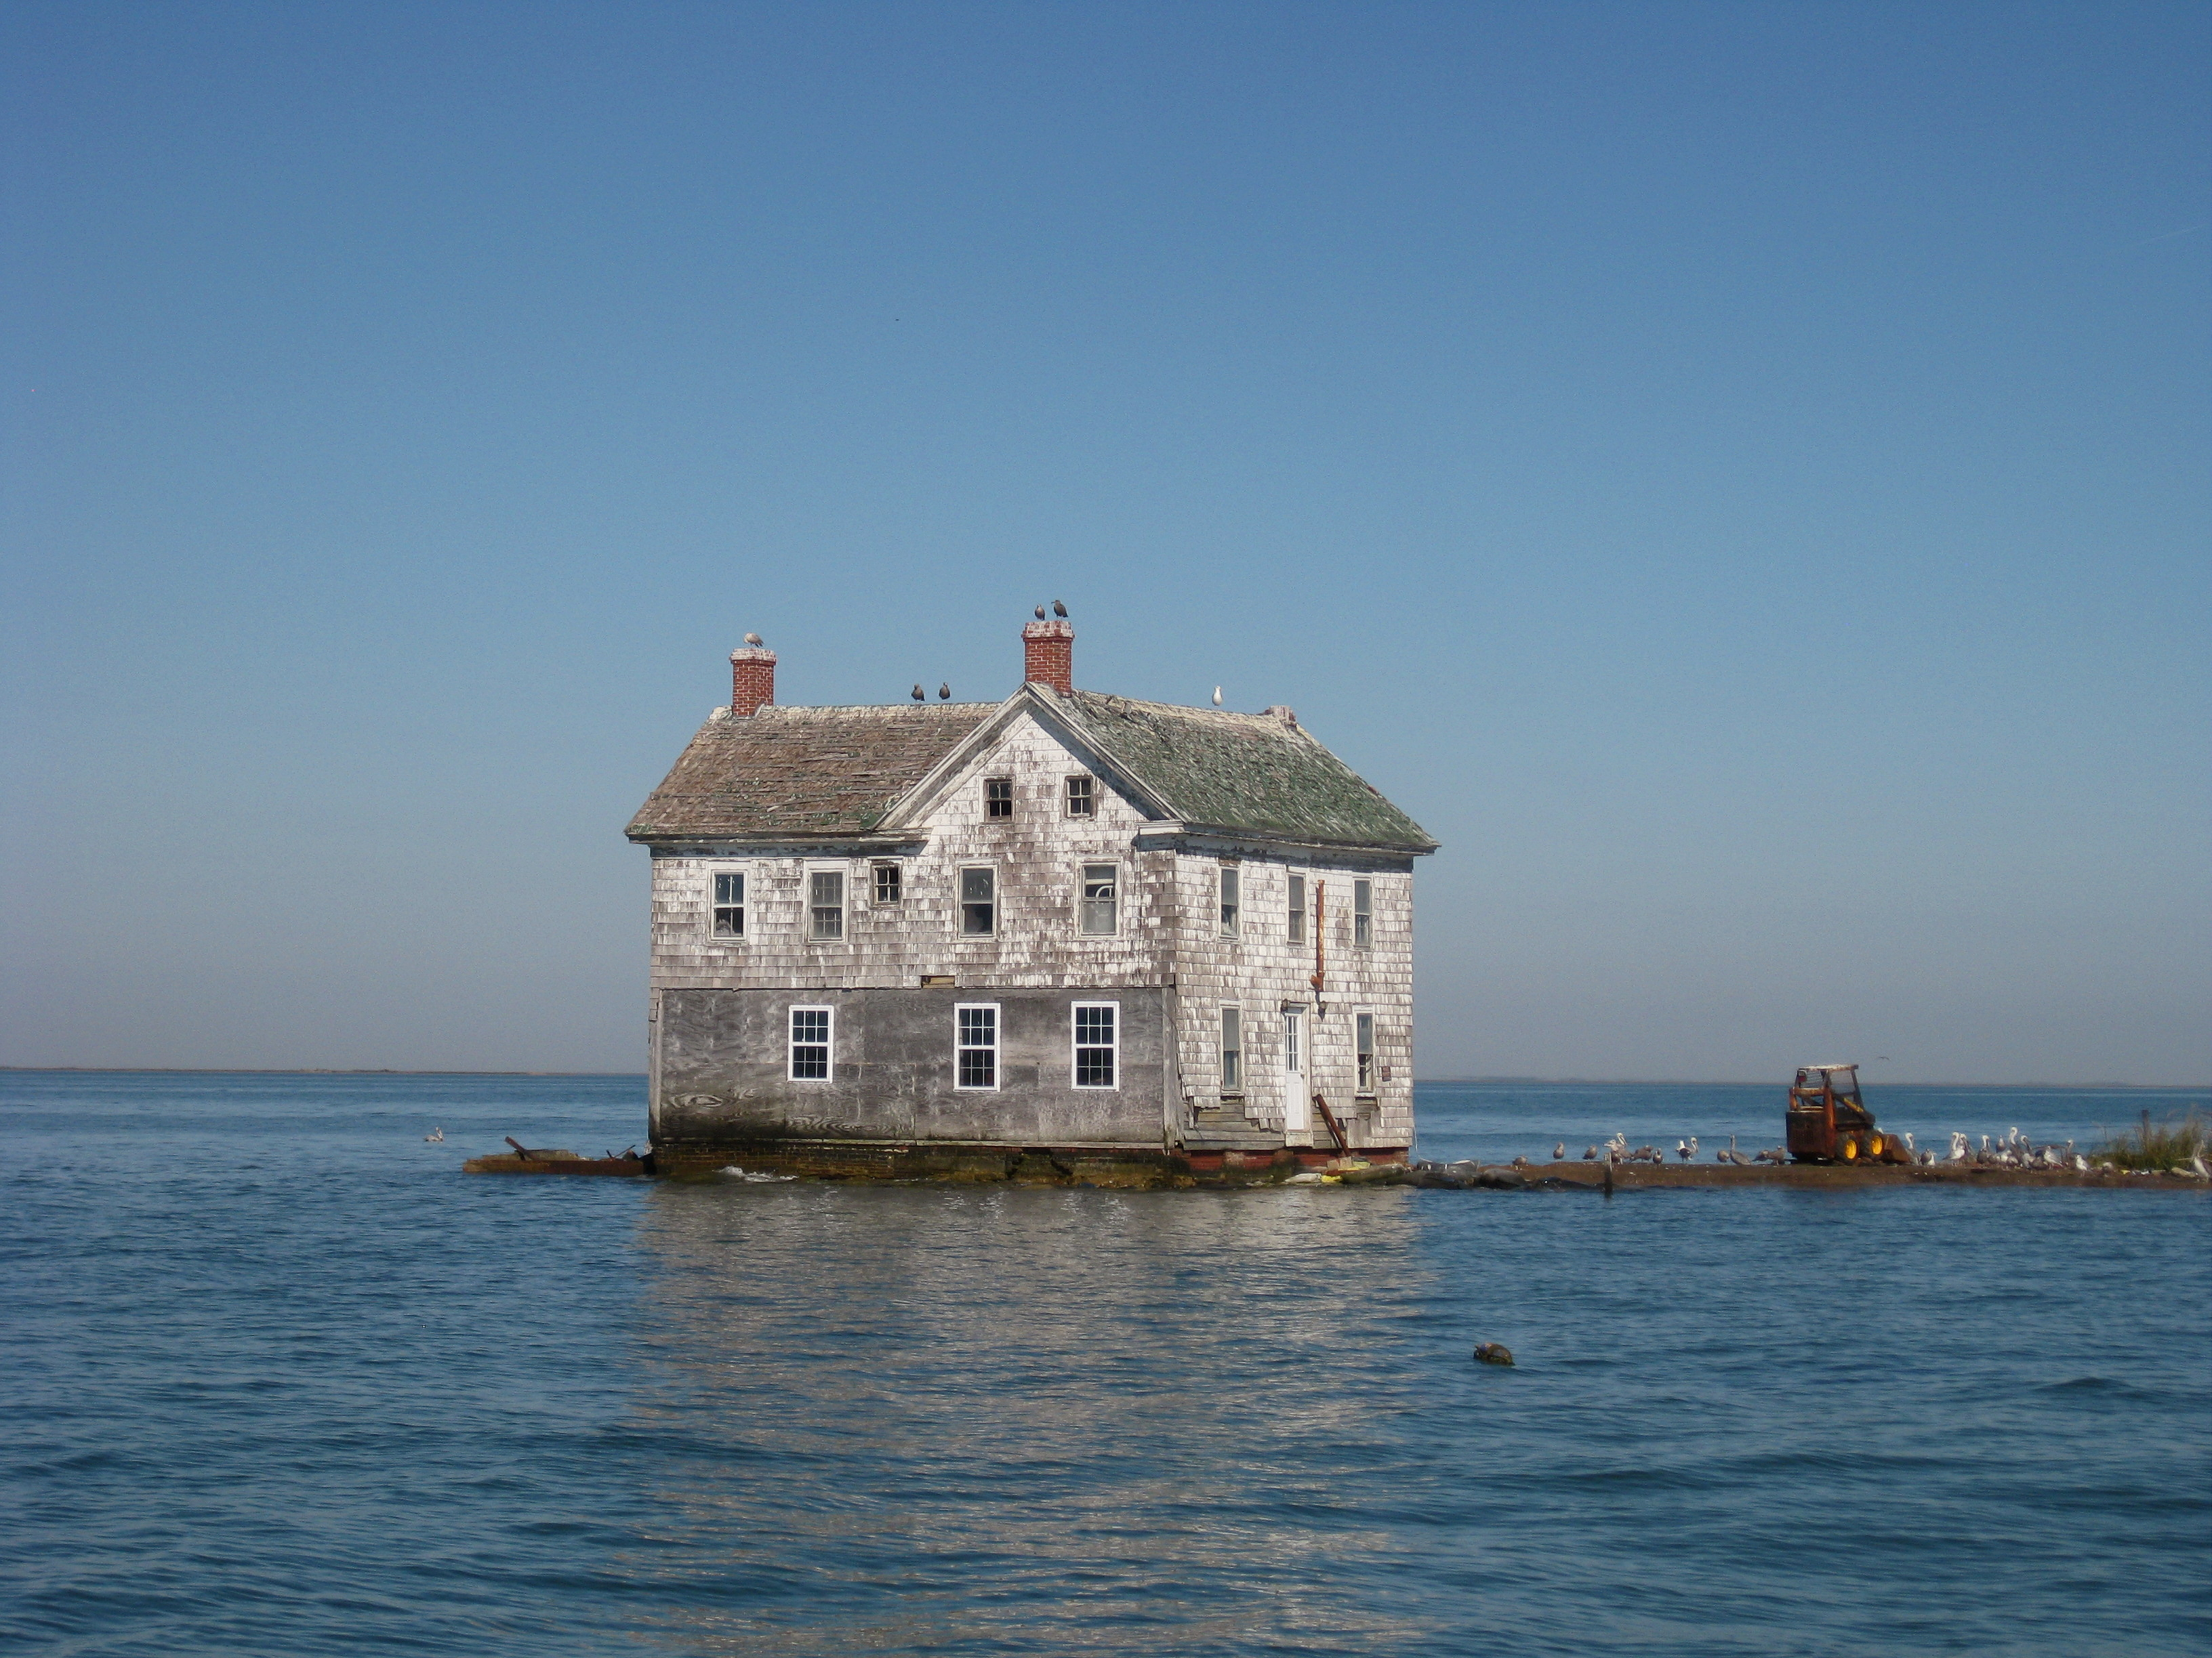
The End.
Disclose It!, v. 2015.11.23
Notes:
licensed under the Creative Commons Attribution-Share Alike 2.0 Generic license.
This image was originally posted to Flickr by baldeaglebluff at http://flickr.com/photos/13731249@N02/4060903093. It was reviewed on 29 October 2010 by the FlickreviewR robot and was confirmed to be licensed under the terms of the cc-by-sa-2.0.
https://commons.wikimedia.org/wiki/File:Holland_Island_house.jpg

